Slide 1
Design and Implementation of a Parallel Graphics Rendering Engine
Kyuhyeon Nam , Ke Wang
EE/CSCI 451: Project Presentation
University of Southern California

Slide 2
Outline
Introduction
Hypothesis
Challenge
Implementation
Performance analysis
Experimental Results and observations
Notes:
Over the past several decades, the field of computer graphics has continuously evolved and advanced, resulting in increasingly realistic graphic images.
These advancements can be attributed to the ever-improving computing power.
We aim to explore the most efficient and fast means of achieving exceptional graphical quality through the utilization of parallel 3D rendering technology.

Slide 3
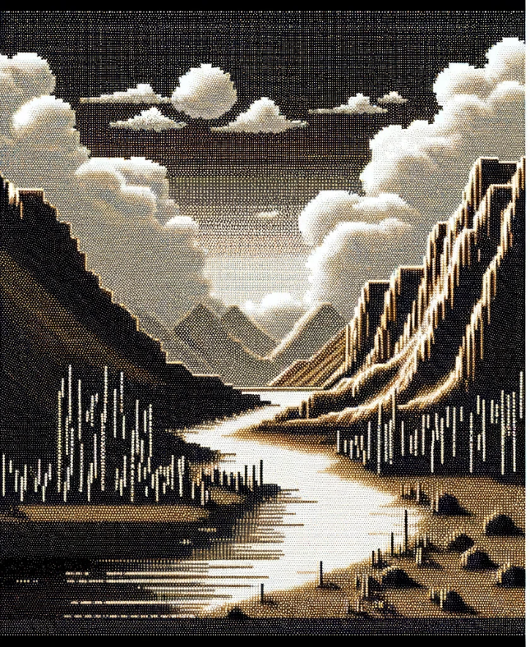

Introduction: Computer Graphics
<Early graphics>
<Modern graphics>
Notes:
Over the past several decades, the field of computer graphics has continuously evolved and advanced, resulting in increasingly realistic graphic images.
These advancements can be attributed to the ever-improving computing power.
We aim to explore the most efficient and fast means of achieving exceptional graphical quality through the utilization of parallel 3D rendering technology.

Slide 4
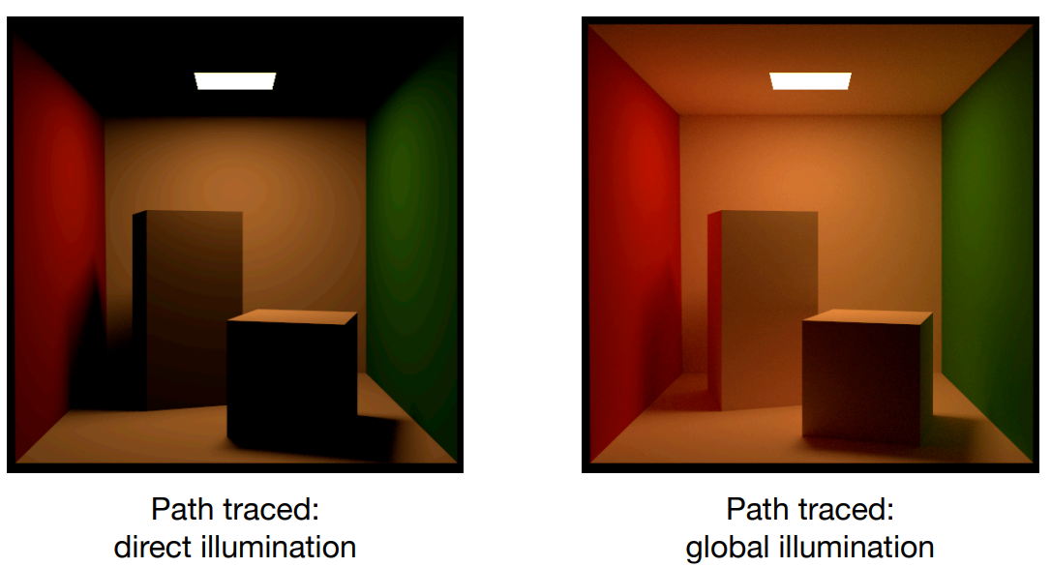
“Path Tracing” for realistic rendering

Slide 5
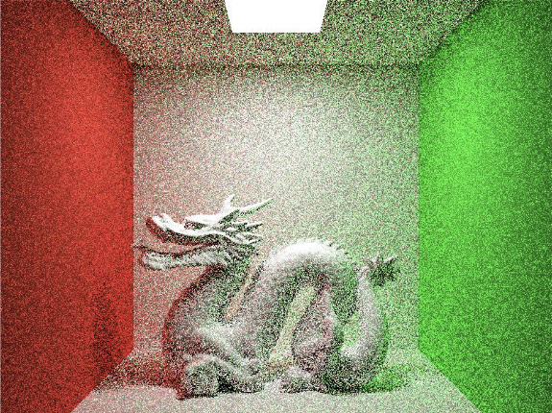
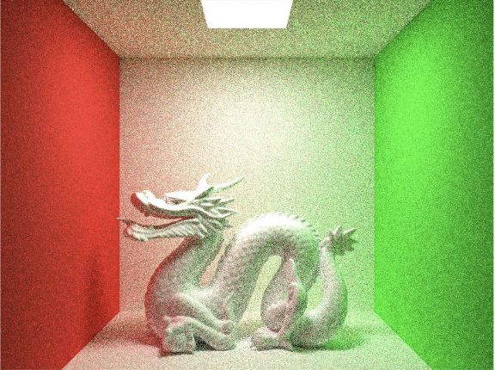
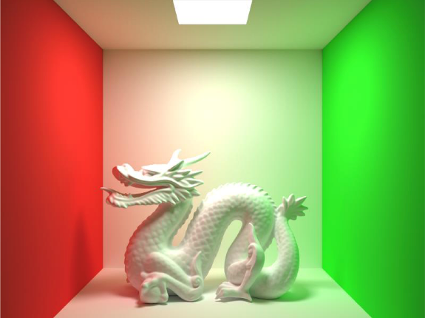
“Path Tracing” for realistic rendering
<1 Path / Pixel>
<10 Path / Pixel>
<10000 Path / Pixel>
Notes:
The visualization showcases how the quality of the final render changes with the number of paths per pixel in the path tracing algorithm.
Path tracing is a rendering technique that simulates how light interacts with surfaces.
It is an enhanced version of ray tracing that calculates multiple possible paths that light can take to reach the camera.

Slide 6
Hypothesis
"Parallel Computing as a Solution”
Scalability--Color of each pixel can be calculated independently (Interactions between the beams are not considered)
Each thread is responsible for multiple pixels(for OpenMP version)
Each thread is responsible for one pixel(for CUDA version)
Using GPU(CUDA) more efficiently reduces rendering time-more resources and high speed computation
Notes:
Our hypothesis is very simple.

Slide 7
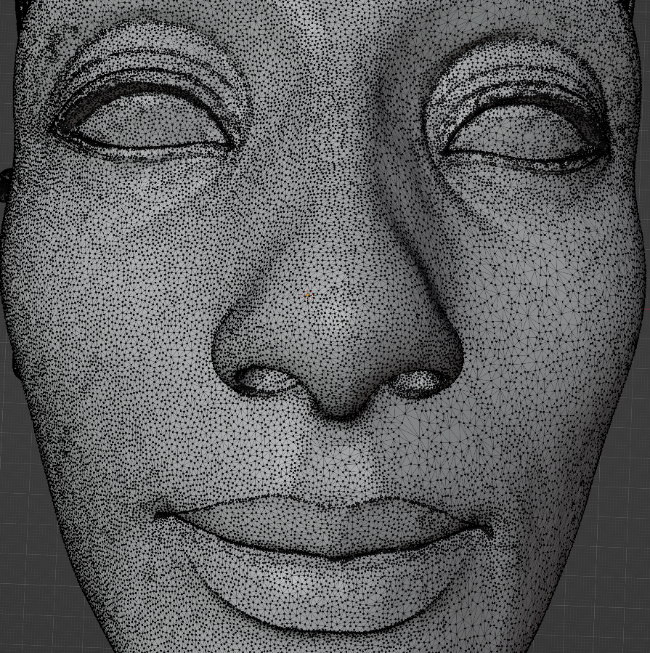
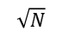
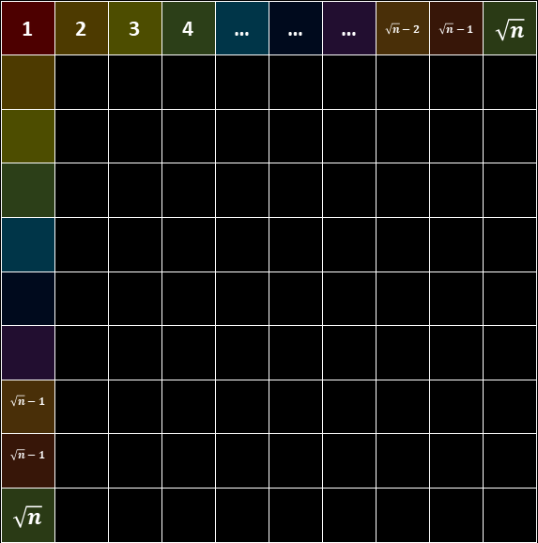
Key idea
$$\sqrt{N}$$
1 | 2 | 3 | 4 | … | … | … | $$\sqrt{n}−2$$ | $$\sqrt{n}−1$$ | $$\sqrt{n}$$
$$\sqrt{n}−1$$
$$\sqrt{n}−1$$
$$\sqrt{n}$$
Changing the algorithm is not our Goal.
N threads responsible for vertices
Assembling Triangle (Vertice → triangle)
Triangle: Move, Scale, Rotate
$$\sqrt{N}$$
Notes:
Our objective is not to change the path-tracing algorithm, even though it could significantly reduce the rendering time.
to parallelize the computation involved in assembling vertices into polygons (triangles in this case)
and performing transformations on those triangles such as moving (translation), scaling, and rotating them.
These operations can be computationally intensive when dealing with a large number of vertices and triangles, making them good candidates for parallelization.

Slide 8
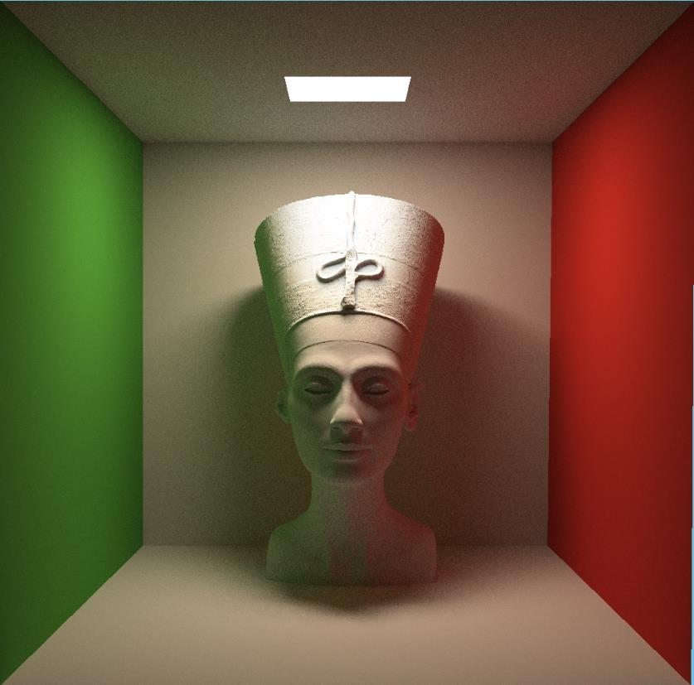
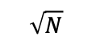
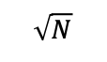
Key idea
$$\sqrt{N}$$
Changing the algorithm is not our Goal.
N threads responsible for each block
BlockSize = No. of Pixel / No. of Threads
$$\sqrt{N}$$

Slide 9
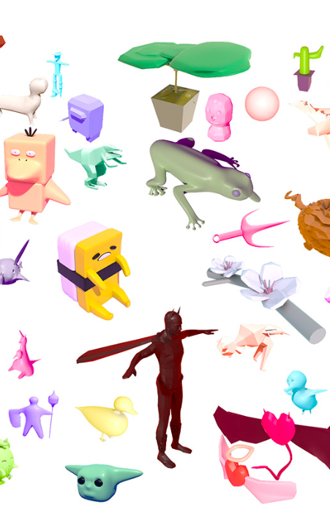
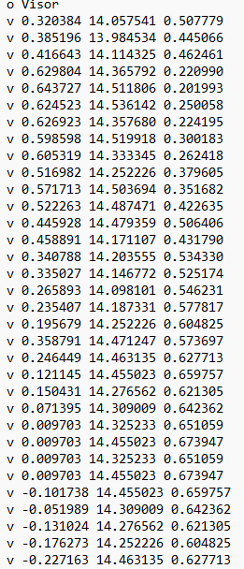
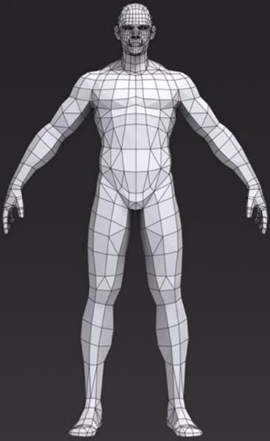
Challenge: Loading the scene
Vertices
Meshes
Triangles
Materials
Textures
Positions
Rotations
...

Slide 10
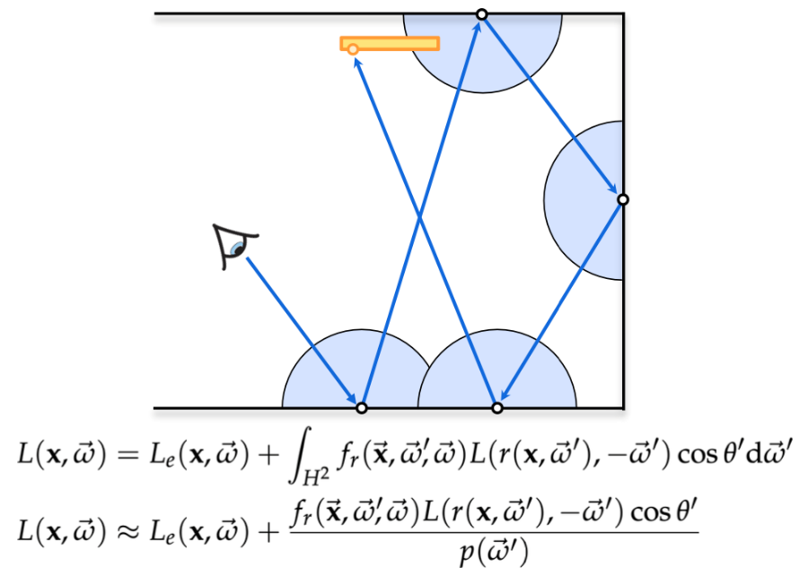
Challenge: Algorithm
Where should I place the camera?
How to calculate ray direction?
How to know if the ray is blocked?
How to simulate the light path in a physical-based way?
Radiance?
How to calculation the integral?
How many times should a ray be reflected?
How to speed up the whole process? —Bounding Volume Hierarchies(BVH)
...

Slide 11
Challenge: Parallelization
Can we parallelize the loading process?
Can we parallelize the algorithm for each pixel? (Multiple sample points)
How to balance the calculation time and the image quality?
Threads number
How to write codes of CUDA programs within cpp project?
Where and when to malloc and memcpy to CUDA memory?
Using shared memory
Memory alignment for coalesced reads from GPU memory
Thread divergence
...

Slide 12
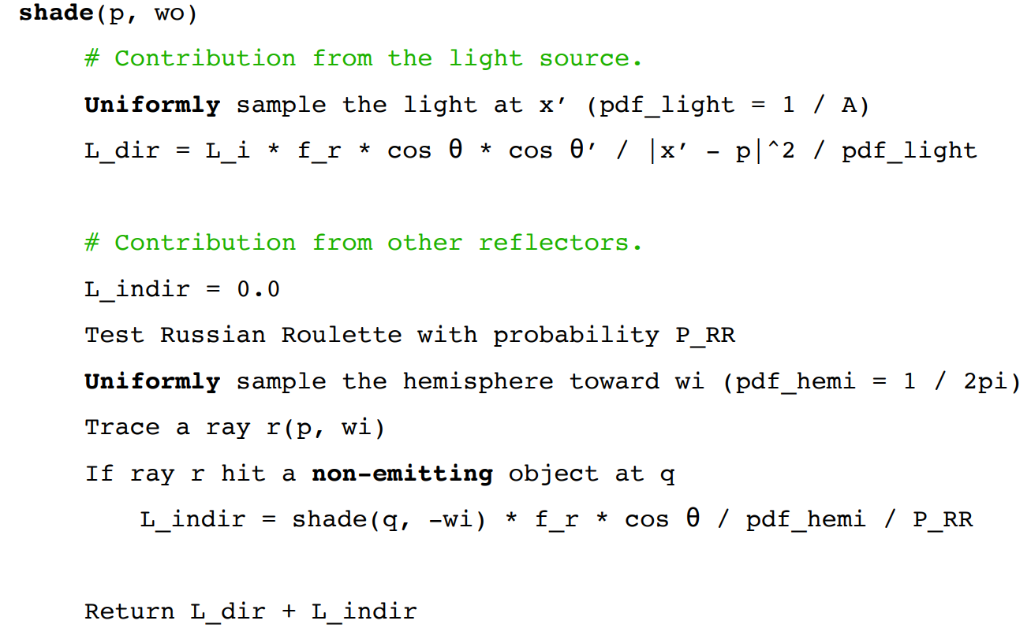
Implementation (for each pixel, each ray)
renamed as ‘CastRay’ in program

Slide 13
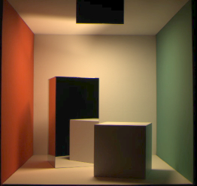
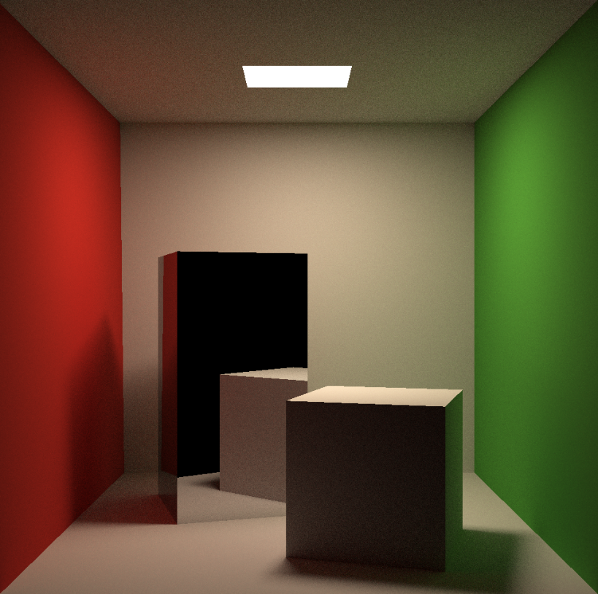
Correctness check
(Cornell Box Data)https://www.graphics.cornell.edu/online/box/data.html

Slide 14
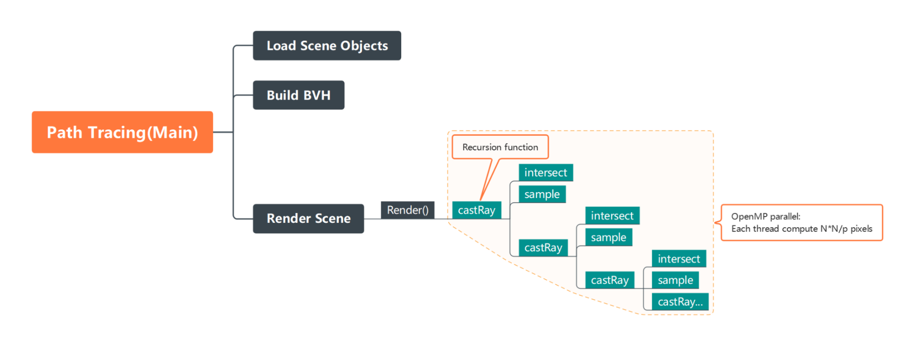
Implementation (OpenMP)

Slide 15
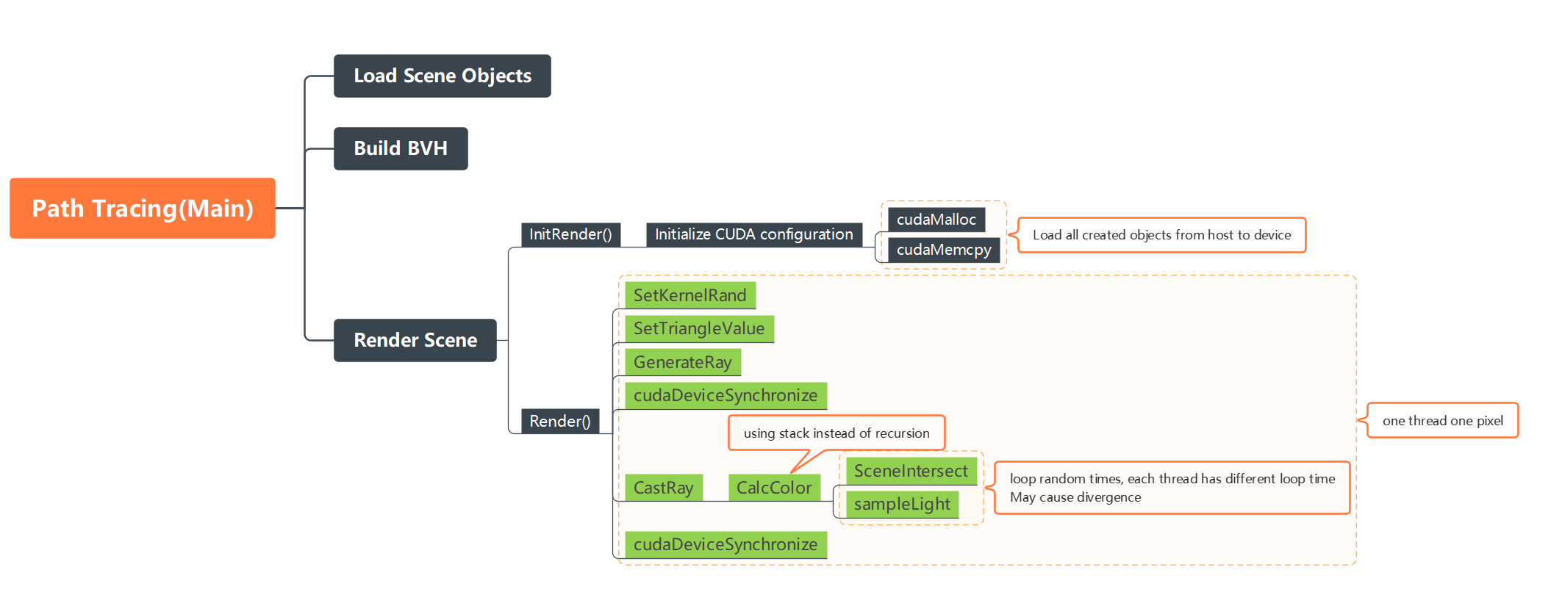
Implementation (CUDA)

Slide 16
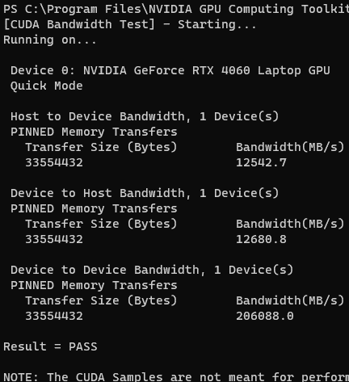
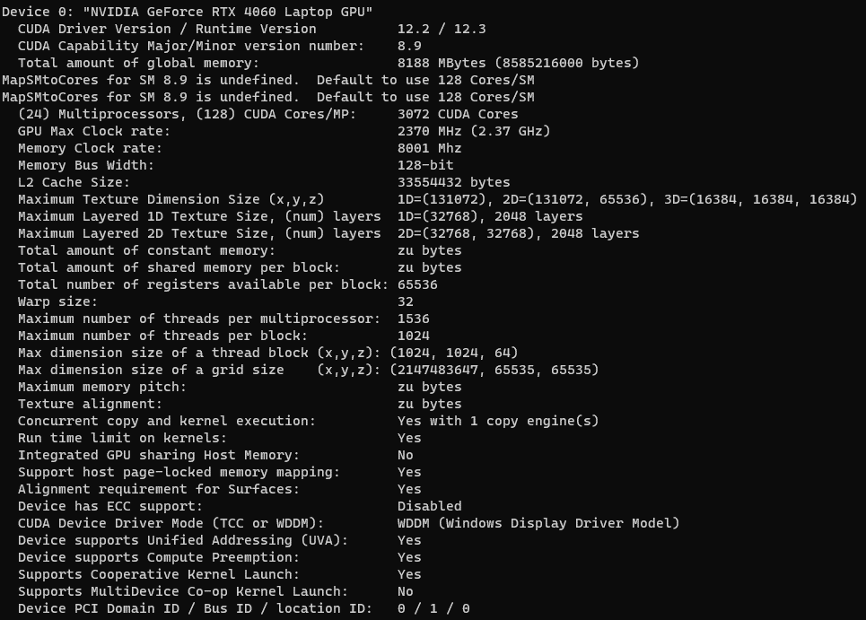
Experimental Setup

Slide 17
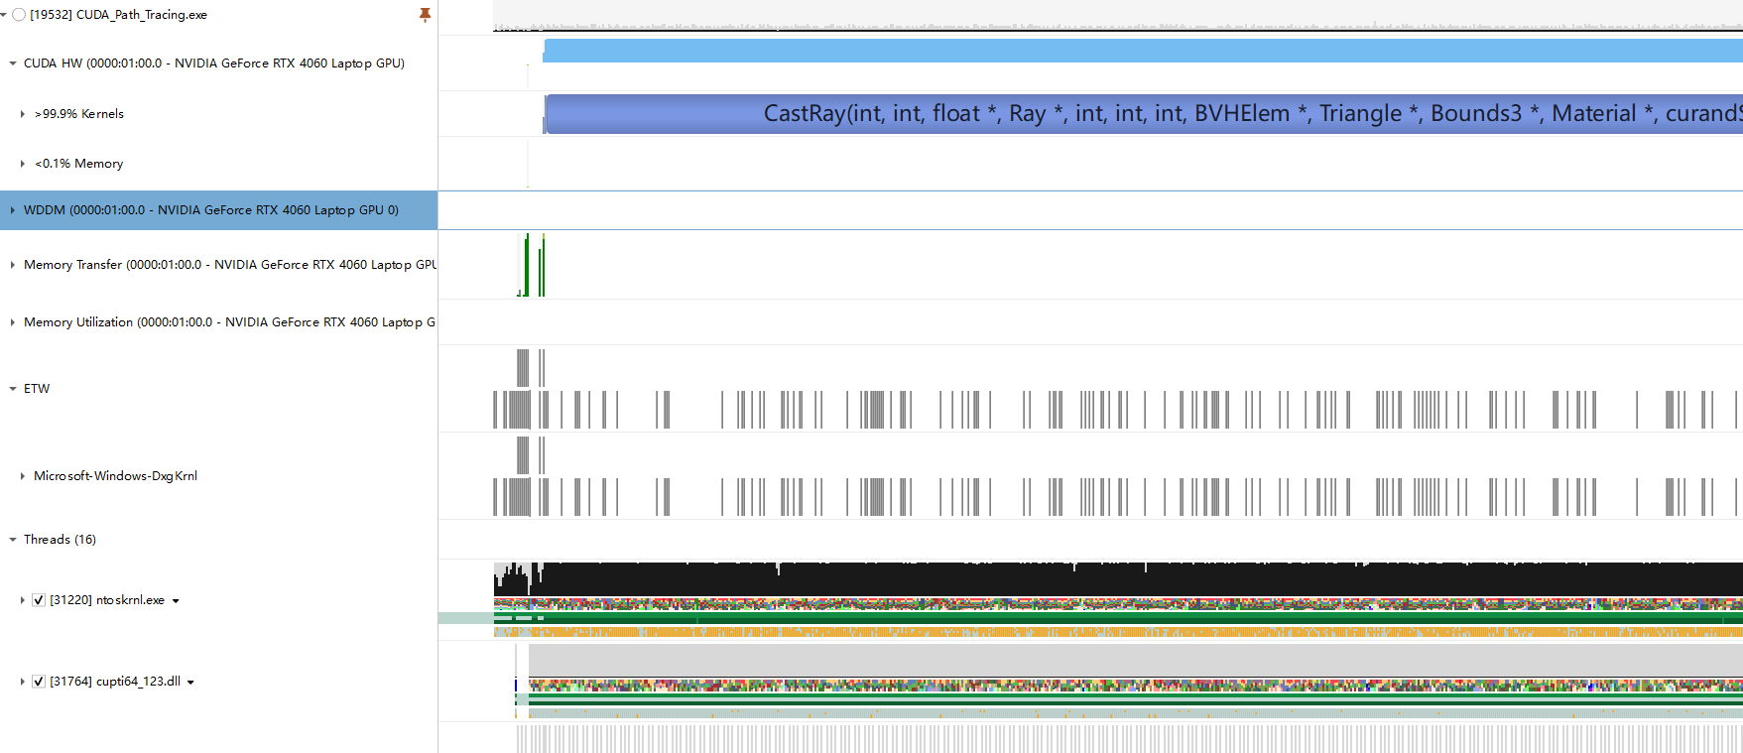
Performance analysis:
Read
Memcpy
Render
Notes:
Rendering takes most of the time we spent, so we will analyze this particular part.

Slide 18
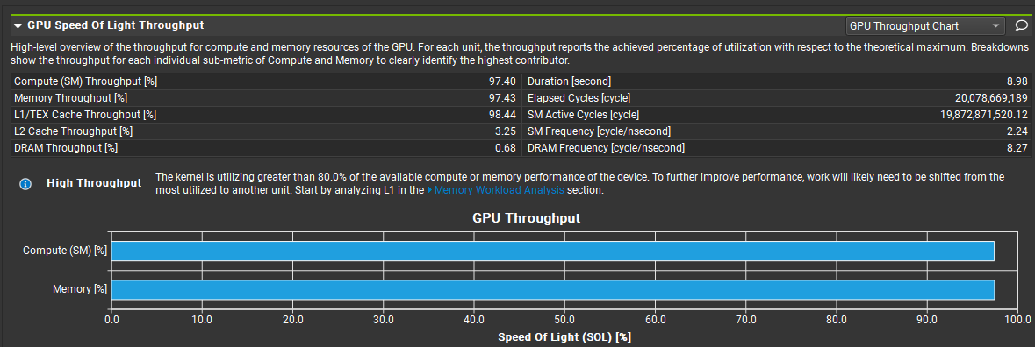
Performance analysis:
Notes:
Generally computing and memory accessing contribute equally to the overall time consumed.

Slide 19
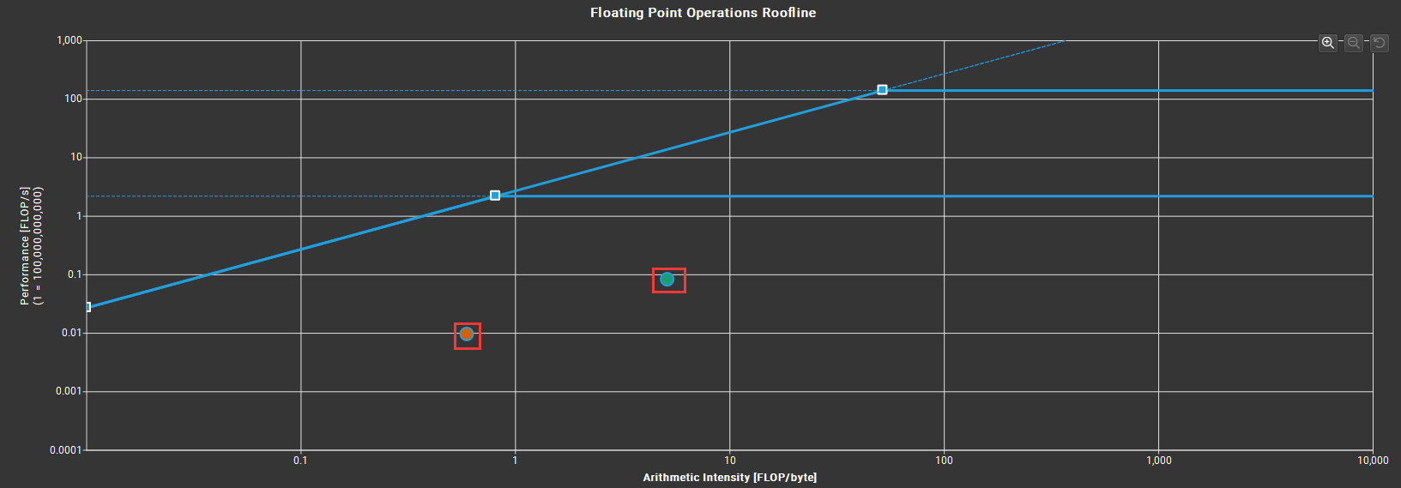
Performance analysis: Roofline Model
Notes:
Memory bound, still a lot of space for improvement.

Slide 20
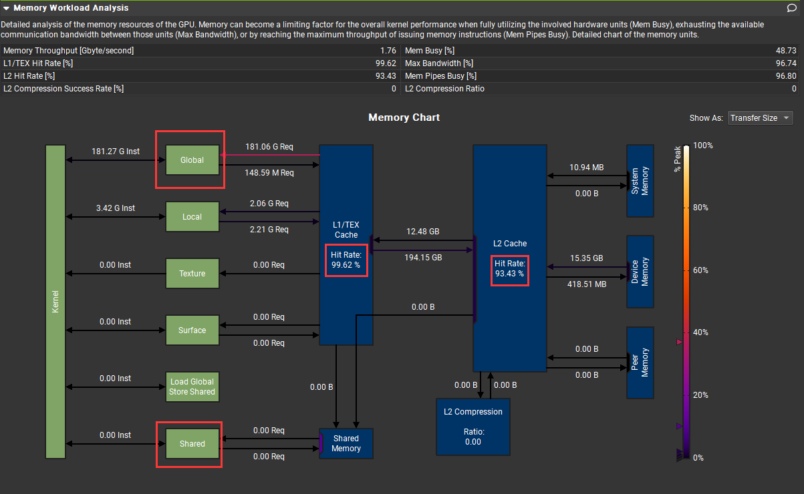
Performance analysis: Cache
Notes:
Hit ratio is high, so the bottle neck would be the memory access time (band width)

Slide 21
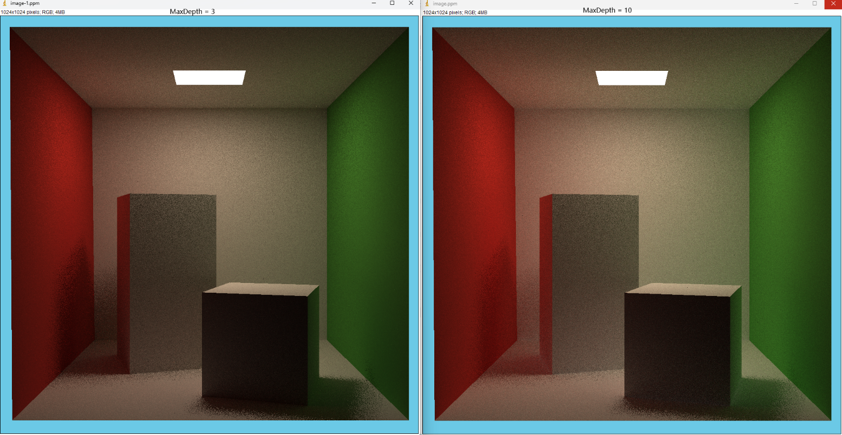
Performance analysis:
Changing MaxDepth will increase calculation time, but have little effect on the result.

Slide 22
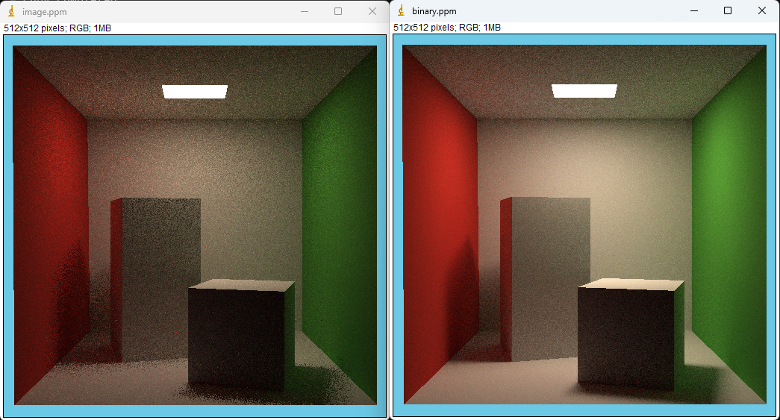
Performance analysis:
8 sec
93 sec
Implementation on CUDA is slightly different to achieve maximized speedup.

Slide 23
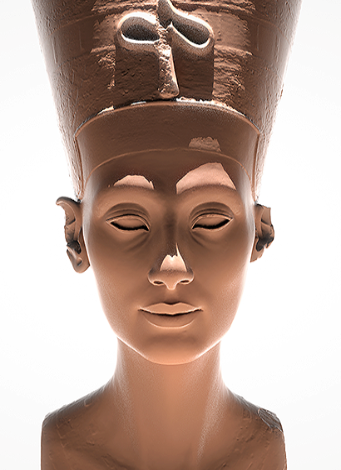
Experimental Setup (openMP)
(Setting) Server with CARC (Intel® Xeon® Silver 4126 CPU @ 2.10Ghz)
cpus-per-task = 8
mem=32G
time=2:00:00
(Model object) Nefertiti.obj
about 2M triangles
file size: 183MB)
Measure single threaded performance and multi threaded performance (using openMP and CUDA)
Resolution(3): 1024x1024, 512x512, 256x256
Path tracing sample space(3): 32, 64, 128
No. of threads(9): 1, 2, 4, 8, 16, 32, 64, 128, 256
Total test set: 81 case (3 x 3 x 9)
Notes:
Next, we'll describe the experiment.
First part is using openMP
we ran our tests using the CARC system so that we could always test under the same conditions.
We set the environment variables the same as in our programming home work, and we set the time to 2 hours to account for the long rendering time.
The object used in the experiment is Nefetiti. This object has 2 million triangles and a file size of about 183 megabytes.
A total of 81 cases were measured.
Three resolutions, three samplespaces, and nine threads.

Slide 24
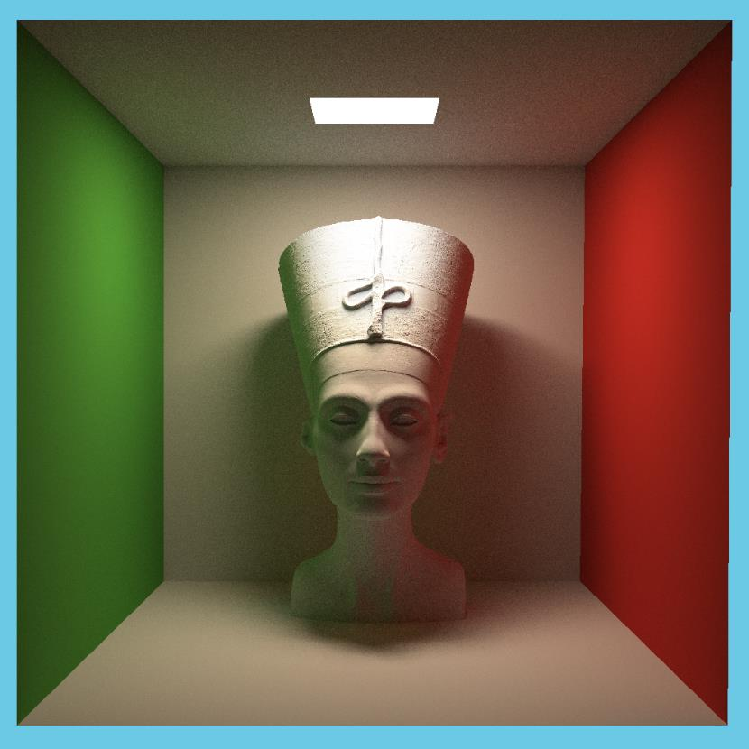
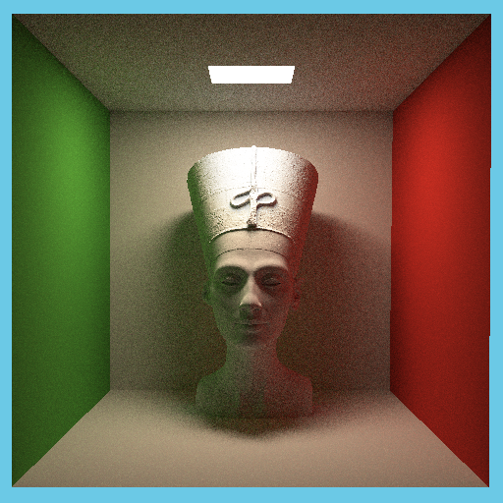
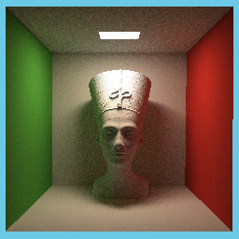
Experimental Results
256 x 256
512 x 512
1024 x 1024
Notes:
The image quality improves significantly as the resolution increases.
At the lowest resolution (256x256), the details are quite blurry and pixelated.
However, at the highest resolution (1024x1024), the image is much clearer, showing a detailed and smooth rendering of the model.

Slide 25

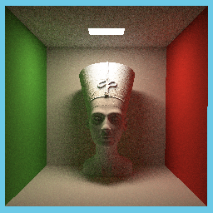
Experimental Results (256 x 256)
SPP= 32
Time(sec)
SPP= 64
SPP= 128
Threads

Slide 26

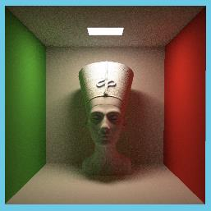

Experimental Results (512 x 512)
SPP= 32
Time(sec)
SPP= 64
SPP= 128
Threads

Slide 27
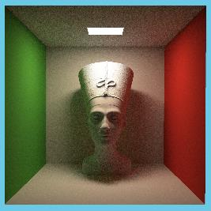
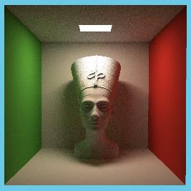

Experimental Results (1024 x 1024)
SPP= 32
Time(sec)
SPP= 64
SPP= 128
Threads
Notes:
Experimental results show that run time decreases as the number of threads increases, but it does not appear to decrease dramatically above a certain point (eight threads here). This may be limited by the number of physical cores in the CPU. In other words, if your processor has eight cores, even with eight or more threads, the number of tasks that can actually be handled simultaneously is limited to eight.
As a result, you can see that adding more threads does not significantly improve performance.
And look at the barchart. The benefit of parallelization was not significant in the memory copy operation. This is because, Limited memory bandwidth, bottlenecks where multiple threads access memory at the same time, overhead or synchronization problems do not seem to bring any benefit to parallelization.
In addition, it seems that the recursive implementation of BVH(Bouding Volume Hierarchy) has not been able to take full advantage of parallelization.

Slide 28
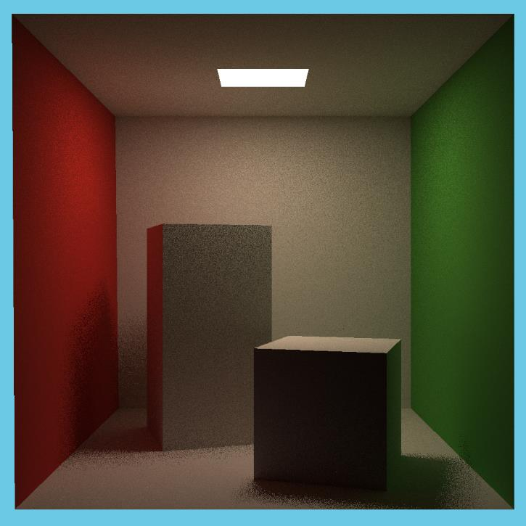

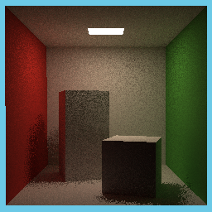
Experimental Results (CUDA)
Resolution: 1024x1024, 512x512, 256x256
Path tracing sample space: 32, 64, 128, 256, 512
Grid Size: 16x16 ~ 1024x1024
256 x 256
512 x 512
1024 x 1024
Notes:
Here's an experiment using CUDA
As with openMP, we were going to use Nefertiti objects to measure performance,
but there were some problem loading large-scale objects in CUDA
So, Instead, more test cases were rendered using block boxes,
3 resolutiton, 5 sample space, and 7 grid size from 16x16 to 1k x 1k

Slide 29
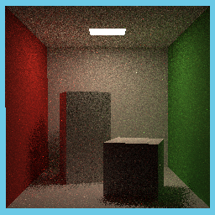


Experimental Results (256 x 256)
Time(sec)
SPP= 32
SPP= 64
SPP= 128
SPP= 512
GridSize
Notes:
overall, the experiments show the same pattern.
We can see that for every doubling of the SPP value, the render time increases by exactly two times.
The increase in time with larger grid sizes could be due to several factors such as:
The overhead of managing a larger number of threads,
Increased complexity in memory management as the grid size grows,
Possible limitations in hardware resources causing contention,
Inefficiencies in the implementation that only become apparent at larger scales.

Slide 30

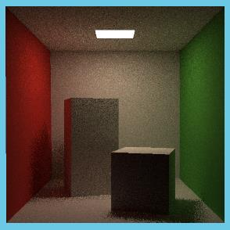


Experimental Results (512 x 512)
Time(sec)
SPP= 32
SPP= 64
SPP= 128
SPP= 512
GridSize

Slide 31
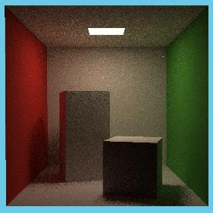
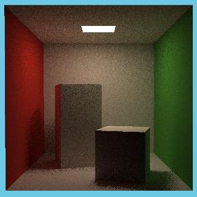
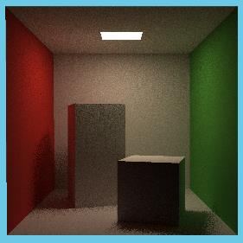

Experimental Results (1024 x 1024)
Time(sec)
SPP= 32
SPP= 64
SPP= 128
SPP= 512
GridSize
Notes:
The results indicate that there may be an optimal grid size for the given hardware and software configuration that balances the overhead of parallelism with the performance gains.
Beyond this optimal point, the cost of managing more threads outweighs the benefits of added parallelism.
This is a common scenario in parallel computing and indicates that there is a need for careful tuning of parallel execution parameters to achieve the best performance.

Slide 32
More optimization!
using shared memory and registers: much faster than using global/local memory
memory alignment for coalesced reads from GPU memory
since CUDA launches a kernel in groups of 32 threads in parallel ("warps"), threads taking different code paths can give rise to thread divergence which reduces the GPU's occupancy.
Since a BVH is built recursively, the child nodes in turn contain pointers to their child nodes and this keeps on going until the leaf nodes are reached. This process involves lots of pointers which might point to scattered locations in memory
TODO:
Align triangle data in float4s (128 bits) for coalesced memory access, maximising memory throughput
for expensive functions (such as sin() and sqrt()), compute fast approximations using single precision intrinsic math functions such as __sinf(), __powf(), __fdividef()
store BVH data in flat one-dimensional arrays

Slide 33
Conclusion
Irregular memory accesses and lack of data locality makes graph processing challenging. We observed that for large datasets, cache efficiency is very poor (30-35% cache miss rate for pld, sd1).
it is important to properly control the number of threads, optimize memory access patterns, and minimize overhead and synchronization costs when performing parallel programming. Designing and optimizing programs with these factors in mind can help improve performance.
there is a need for careful tuning of parallel execution parameters to achieve the best performance.

Slide 34
References
[1] “OpenGL shading language”, Rost, Randi J ; Licea-Kane, Bill ; Ginsburg, Dan ; Kessenich, John ; Lichtenbelt, Barthold ; Malan, Hugh ; Weiblen, Mike, Pearson Addision Wiseley; 2021
[2] “Computer Graphics Programming in OpenGL with C++”, Gordon, V.scott, Bloomfield, New jersey : Mercury Learning & Information; 2020
[3] OpenGL, https://www.opengl.org, accessed 2023-10-20
[4] KHORONOS group, https://www.khronos.org/opengl, accessed 2023-10-20
[5] “PATH TRACING: A NON-BIASED SOLUTION TO THE RENDERING EQUATION”, ROBERT CARR AND BYRON HULCHER
[6] “Real-Time Bidirectional Path Tracing via Rasterization” Yusuke Tokuyoshi∗ Square Enix Co., Ltd. Shinji Ogaki† Square Enix Co., Ltd.
[7] “An Improved Illumination Model for Shaded Display”, Turner Whitted, 1980
[8] “Distributed Ray Tracing”, Cook, Porter, Carpenter, 1984
[9] “The Rendering Equation”, James Kajiya, 1986 • “Bidirectional Path Tracing”, Eric Lafortune, Yves Willems, 1993
[10] “Rendering Caustics on Non-Lambertian Surfaces”, Henrik Wann Jensen, 1996
[11] “Metropolis Light Transport”, Eric Veach, Leonidas Guibas, 1997
[12] “A Reflectance Graphics ” ROBERT L. COOK Lucasfilm Ltd. and KENNETH E. TORRANCE Cornell University
[13] “Real-Time Rendering Fourth Edition “, Tomas Akenine-M ̈oller Eric Haines Naty Hoffman Angelo Pesce , Michal Iwanicki S ́ebastien Hillaire; November 5, 2018

Slide 35
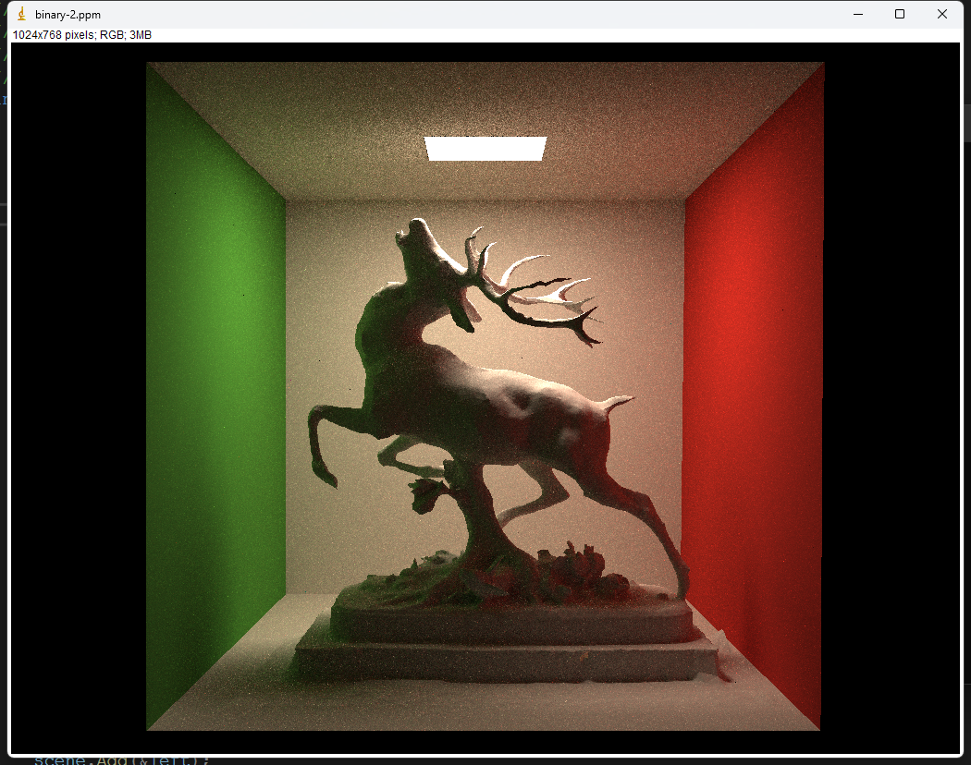
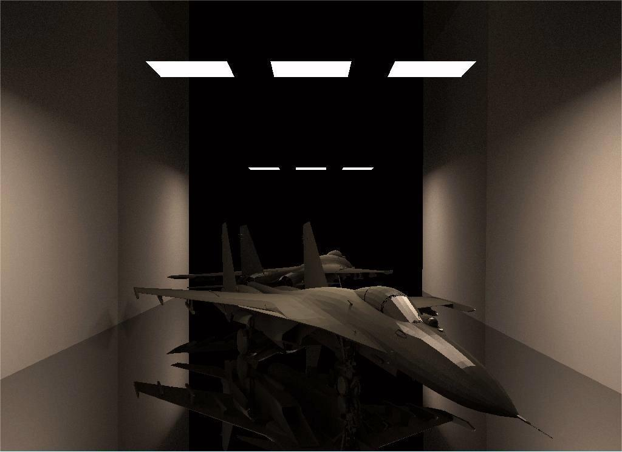
Showcase

Slide 36
Thank You.

